Slide 1
Introduction to information security
Information security: a “well-informed sense of assurance that the information risks and controls are in balance.” — Jim Anderson, Invent (2002)‏
Security professionals must review the origins of this field to understand its impact on our understanding of information security today

Slide 2
What is information security
The protection of information and information systems from unauthorised access, use, or disruption.
It is important for employees and all stakeholders to understand information security policies and guidelines. It is also necessary to have good work practices that comply with security policies so that the effects of possible breaches can be minimised.

Slide 3
The History of Information Security
Began immediately following development first mainframes
Developed for code-breaking computations
During World War II
Multiple levels of security were implemented
Physical controls
Rudimentary
Defending against physical theft, espionage, and sabotage

Slide 4
The History Of Information Security
The need for computer security, or the need to secure the physical location of hardware from outside threats, began almost immediately after the first mainframes were developed.Groups developing code-breaking computations during World War II created the first modern computers .Badges, keys, and facial recognition of authorized personnel controlled access to sensitive military locations.
In contrast, information security during these early years was rudimentary and mainly composed of simple document classification schemes.There were no application classification projects for computers or operating systems at this time, because the primary threats to security were physical theft of equipment, espionage against the products of the systems, and sabotage.

Slide 5
The 1960s
Original communication by mailing tapes
Advanced Research Project Agency (ARPA)
Examined feasibility of redundant networked communications
Larry Roberts developed ARPANET from its inception
Plan
Link computers
Resource sharing
Link 17 Computer Research Centers
Cost 3.4M
ARPANET is predecessor to the Internet
The 1960sDuring the 1960s, the Department of Defence's Advanced Research Procurement Agency (ARPA) began examining the feasibility of a redundant networked communications system designed to support the military’s need to exchange information.Larry Roberts, known as the founder of the Internet, developed the project from its inception.

Slide 6
The 1970s and 80s(cont’d.)
The 1970s and 80s ARPANET grew in popularity
Potential for misuse grew
Fundamental problems with ARPANET security
- Individual remote sites were not secure from unauthorized users
- Vulnerability of password structure and formats
- No safety procedures for dial-up connections to ARPANET
- Non-existent user identification and authorization to system

Slide 7
In December of 1973, Robert M. Metcalfe indicated that there were fundamental problems with ARPANET security.Individual remote users’ sites did not have sufficient controls and safeguards to protect data against unauthorized remote users.There were no safety procedures for dial-up connections to the ARPANET.User identification and authorization to the system were non-existent.Phone numbers were widely distributed and openly publicized on the walls of rest rooms and phone booths, giving hackers easy access to ARPANET.
Much of the focus for research on computer security centered on a system called MULTICS (Multiplexed Information and Computing Service).In mid-1969, not long after the restructuring of the MULTICS project, several of the key players created a new operating system called UNIX.While the MULTICS system had planned security with multiple security levels and passwords, the UNIX system did not.In the late 1970s the microprocessor brought in a new age of computing capabilities and security threats as these microprocessors were networked.

Slide 8
The 1970s and 80s (cont’d.)
Rand Report R-609 - Paper that started the study of computer security
- Information Security as we know it bega
‏Scope of computer security grew from physical security to include:
- Safety of data
- Limiting unauthorized access to data
- Involvement of personnel from multiple levels of an organization

Slide 9
MULTICS
Early focus of computer security research
- System called Multiplexed Information and Computing Service (MULTICS)
First operating system created with security as its primary goal
Mainframe, time-sharing OS developed in mid-1960s
- GE, Bell Labs, and MIX
‏Several MULTICS key players created UNIX
Late 1970s
- Microprocessor expanded computing capabilities
- Mainframe presence reduced
- Expanded security threats

Slide 10
The 1990s
Networks of computers became more common
Need to interconnect networks grew
Internet became first manifestation of a global network of networks
Initially based on de facto standards
In early Internet deployments, security was treated as a low priority
At the close of the 20th century, as networks of computers became more common, so too did the need to connect the networks to each other.This gave rise to the Internet, the first manifestation of a global network of networks.There has been a price for the phenomenal growth of the Internet, however. When security was considered at all, early Internet deployment treated it as a low priority.As the requirement for networked computers became the dominant style of computing, the ability to physically secure that physical computer was lost, and the stored information became more exposed to security threats.

Slide 11
2000 to Present
Millions of computer networks communicate
Many of the communication unsecured
Ability to secure a computer’s data influenced by the security of every computer to which it is connected
Growing threat of cyber attacks has increased the need for improved security
the Internet has brought millions of unsecured computer networks into communication with each other.Our ability to secure each computer’s stored information is now influenced by the security on each computer to which it is connected.

Slide 12
What is Security?
In general, security is “the quality or state of being secure--to be free
from danger.”It means to be protected from adversaries—from those
who would do harm, intentionally or otherwise.
A successful organization should have the following multiple layers of security in place for the protection of its operations:
Physical security – To protect the physical items, objects, or areas of an organization from unauthorized access and misuse.
Personal security – To protect the individual or group of individuals who are authorized to access the organization and its operations.
Operations security – To protect the details of a particular operation or series of activities.
Communications security – To protect an organization’s communications media, technology, and content.
Network security – To protect networking components, connections, and contents.
Information security –To protect the confidentility,inigrity and avilability of information assets,whether in storage,processing and transmission.

Slide 13
What is Security? (cont’d.)
The protection of information and its critical elements, including systems and hardware that use, store, and transmit that information
Necessary tools: policy, awareness, training, education, technology
C.I.A. triangle
- Was standard based on confidentiality, integrity, and availability
- Now expanded into list of critical characteristics of information

Slide 14
What Is Information Security?
Information security, therefore, is the protection of information and its critical elements, including the systems and hardware that use, store, and transmit that information.
But to protect the information and its related systems from danger, tools, such as policy, awareness, training, education, and technology are necessary.
The C.I.A. triangle has been considered the industry standard for computer security since the development of the mainframe. It was solely based on three characteristics that described the utility of information: -
Confidentiality:- Confidentiality protectects the privacy of data by ensuring that only the intended recipient can see it if we do not protect the Confidentiality of data who has access to the data will be able to see it.

Slide 15
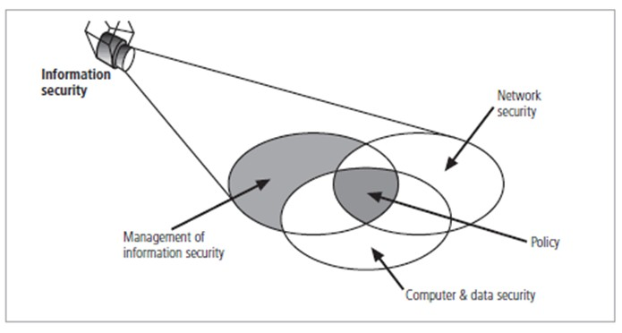
2) Intigrity:- Integrity ensures that data cannot be modified without being detected. If we do not ensure the integrity of data, then it can be modified without our knowledge.
So as a result, we may end up using corrupted data. Which can damage our systems and cause us to lose information.
For example, if we change a file without being aware that we are doing this. Then the data in the file will become corrupted.
3) Availability:- Availability ensures that data is accessible. Especially, in the time it needs to be viewed.
If we do not ensure the availability of data, then users may not be able to access it. As a result, they may lose valuable information.
For instance, if a user cannot access certain files then it can be a big problem. Such as a high possibility that he or she will compromise with other stakeholders.
So, ensuring that information is always available to users can help keep them happy. Also, secure and at ease that any moment they need it, it is there.

Slide 16
Key Information Security Concepts
Access - a subject or object’s ability to use, manipulate, modify, or affect another subject or object.
Asset - the organizational resource that is being protected.
Attack - an act that is an intentional or unintentional attempt to cause damage or compromise to the information and/or the systems that support it.
Control, Safeguard, or Counsure - security mechanisms, policies, or procedures that can successfully counter attacks, reduce risk, resolve vulnerabilities, and otherwise improve the security within an organization.
Exploit - to take advantage of weaknesses or vulnerability in a system.
Exposure - a single instance of being open to damage.
Hack - Good: to use computers or systems for enjoyment; Bad: to illegally gain access to a computer or system.
Object - a passive entity in the information system that receives or contains information.
Risk - the probability that something can happen.
Security Blueprint - the plan for the implementation of new security measures in the organization.
Security Model - a collection of specific security rules that represents the implementation of a security policy.Security Posture or Security
Subject - an active entity that interacts with an information system and causes information to move through the system for a specific end purpose
Threats - a category of objects, persons, or other entities that represents a potential danger to an asset.
Threat Agent - a specific instance or component of a more general threat.
Vulnerability - weaknesses or faults in a system or protection mechanism that expose information to attack or damage.

Slide 17
Key Information Security Concepts (cont’d.)
Computer can be subject of an attack
Computer can be the object of an attack
- When the subject of an attack
- Computer is used as an active tool to conduct attack
When the object of an attack
Computer is the entity being attacked
When considering the security of information systems components, it is important to understand the concept of the computer as the subject of an attack as opposed to the computer as the object of an attack.When a computer is the subject of an attack, it is used as an active tool to conduct the attack. When a computer is the object of an attack, it is the entity being attacked.

Slide 18
Critical Characteristics of Information
The value of information comes from the characteristics it possesses.
Availability – Enables users who need to access information to do so without interference or obstruction and in the required format. The information is said to be available to an authorized user when and where needed and in the correct format.
Accuracy – Free from mistake or error and having the value that the end user expects. If information contains a value different from the user’s expectations due to the intentional or unintentional modification of its content, it is no longer accurate.
Authenticity –The quality or state of being genuine or original, rather than a reproduction or fabrication. Information is authentic when it is the information that was originally created, placed, stored, or transferred.
Confidentiality – The quality or state of preventing disclosure or exposure to unauthorized individuals or systems.
Integrity – The quality or state of being whole, complete, and uncorrupted. The integrity of information is threatened when the information is exposed to corruption, damage, destruction, or other disruption of its authentic state.
Utility – The quality or state of having value for some purpose or end. Information has value when it serves a particular purpose. This means that if information is available, but not in a format meaningful to the end user, it is not useful.
Possession – The quality or state of having ownership or control of some object or item. Information is said to be in possession if one obtains it, independent of format or other characteristic. While a breach of confidentiality always results in a breach of possession, a breach of possession does not always result in a breach of confidentiality.

Slide 19
Components of an Information System
A set of components called the information system, which deals with collecting and organizing data and information. An information system is described as having five components.
hardware:-Hardware can be as small as a smartphone that fits in a pocket or as large as a supercomputer that fills a building. Hardware also includes the peripheral devices that work with computers, such as keyboards, external disk drives, and routers. environment.
Software:-The primary piece of system software is the operating systems, suchas Windows or iOS, which manages the hardware’s operation. Application software is designed for specific tasks, such as handling a spreadsheet, creating a document, or designing a Web page.
Telecommunications:- This component connects the hardware together to form a network. Connections can be through wires, such as Ethernet cables or fibre optics, or wireless, such as through Wi-Fi. A network can be designed to tie together computers in a specific area, such as an office or a school, through a local area network (LAN). If computers are more dispersed, the network is called a wide area network (WAN). The Internet itself can be considered a network of networks.
Data:- A database is a place where data is collected and from which it can be retrieved by querying it using one or more specific criteria. A data warehouse contains all of the data in whatever form that an organization needs. Databases and data warehouses have assumed even greater importance in information systems with the emergence of “big data,” a term for the truly massive amounts of data that can be collected and analyzed.
Procedures:- the people that are needed to run the system and the procedures they follow so that the knowledge in the huge databases and data warehouses can be turned into learning that can interpret what has happened in the past and guide future action.

Slide 20
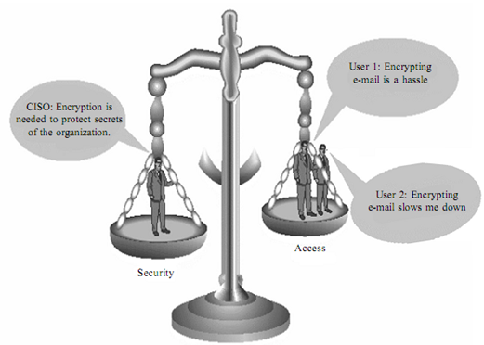
Balancing Information Security and Access
Impossible to obtain perfect security
Process, not an absolute
Security should be considered balance between protection and availability
Must allow reasonable access, yet protect against threats

Slide 21
Need for Information Security
Informaton systems means to consider available counter measures or controls stimulated through uncovered vulnerabilities and identify an area where more work is needed. The purpose of data security management is to make sure business continuity and scale back business injury by preventing and minimizing the impact of security incidents.
Protecting the functionality of the organization:- The decision maker in organizations must set policy and operates their organization in compliance with the complex, shifting legislation, efficient and capable applications.
Enabling the safe operation of applications: - The modern organization needs to create an environment that safeguards application using the organizations IT systems, particularly those application that serves as important elements of the infrastructure of the organization.
Protecting the data that the organization collect and use: - The values of the data motivated the attackers to seal or corrupts the data. This is essential for the integrity and the values of the organization’s data. Information security ensures the protection of both data in motion as well as data in rest.
Safeguarding technology assets in organizations: - The organization must add intrastate services based on the size and scope of the organization. Organizational growth could lead to the need for public key infrastructure, PKI an integrated system of the software, encryption methodologies. The information security mechanism used by large organizations is complex in comparison to a small organization. The small organization generally prefers symmetric key encryption of data.

